Slide 1

City Climate Explorer: Web App for Temperature and Pollution Analysis
Data Programming Final Project-Group 3
Professor: Roshan Sahu

Slide 2
Meet our team
Name | Role | Experience/Skills
Moganaviniith Rathinavel | Project Manager | 3+ years of experience as a project coordinator in developing business, strategies, signing Mou's with organizations, experience in project management tools like Jira, MS project and monday.com for making perfect schedule.
Nanditha Babu | Data Analyst | 3+ Years of experience in collecting data, Data cleaning and preprocessing skills are crucial. Assuring data quality, addressing missing data, and eliminating outliers. which is valuable as a data analyst. A strong understanding of SQL (Structured Query Language) is crucial for data retrieval and manipulation from relational databases.
Srivas Sathyanarayanan | Developer | A programmer with more than 2 years of Java, Python, and SQL experience. An expert Python user, web developer, and data analyst. Complex querying, database design, and optimization are all areas of MySQL expertise. Know all stages of the development life cycle, went to client meetings, and collected business analyst's needs.
Darshan Tahiliani | Business Analyst | Bachelors of Engineering in Computer Science Post graduate diploma in Information systems Security. Communication, and problem-solving skills to gather and document requirements, analyze data, and facilitate effective decision-making. Proficiency in project management, technical understanding, and adaptability are also crucial for success in translating business needs into actionable solutions.
Rohan Juneja | Business Analyst | Bachelor in Computer Science Engineering ,Post graduate diploma in Information systems security. Analytical thinking, effective communication, and problem-solving, while also demonstrating proficiency in project management, technical understanding, and adaptability to bridge the gap between business requirements and practical solutions. Key attributes include strong interpersonal skills, industry knowledge, and the ability to facilitate collaboration among diverse stakeholders.

Slide 3
Project summary
Information on the temperature and pollution levels of all cities worldwide will be provided by this project.
The temperature status includes a visual chart that displays a variety of data, including the city's name, country code, humidity, and pressure.
The pollution status report includes a number of data, including the air quality index and the concentrations of various pollutants, including ammonia, carbon dioxide, nitrogen dioxide, ozone, sulfur dioxide, and particulates (PM2.5 and PM10).
Data visualization is offered for information on pollution and temperature.
The project is housed on the AWS Live Cloud, utilizing a Rest API to provide data for each element categorized by ID.

Slide 4
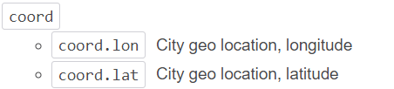
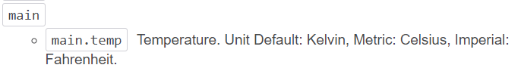
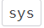
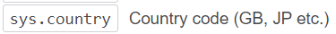
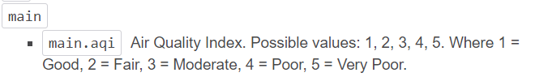
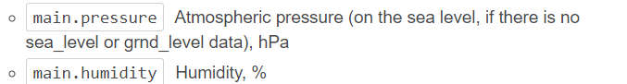
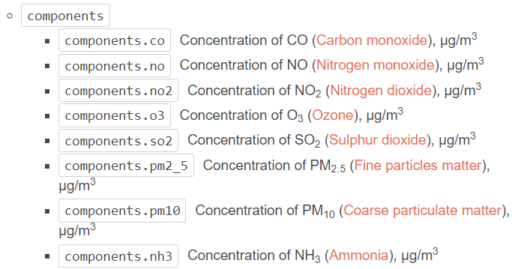
Dataset Description
Data source: https://openweathermap.org/
Data is available in JSON format

Slide 5





Tools used
Framework - Python Django
Database – pgAdmin(PostgreSQL)
Visualization – google charts
UI – JavaScript/HTML/CSS
Cloud – AWS(EC2, RDS, Elastic IP)

Slide 6
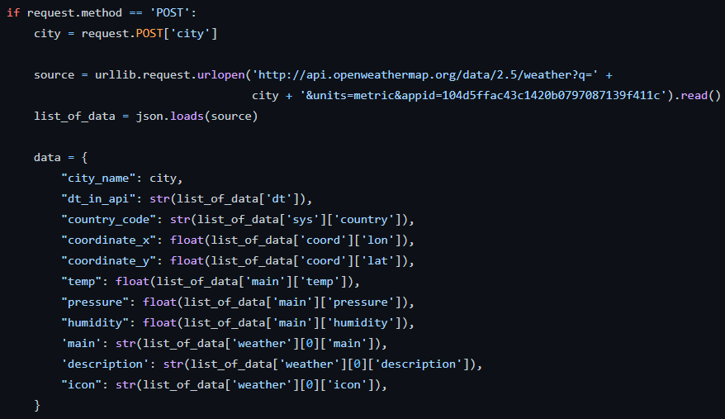
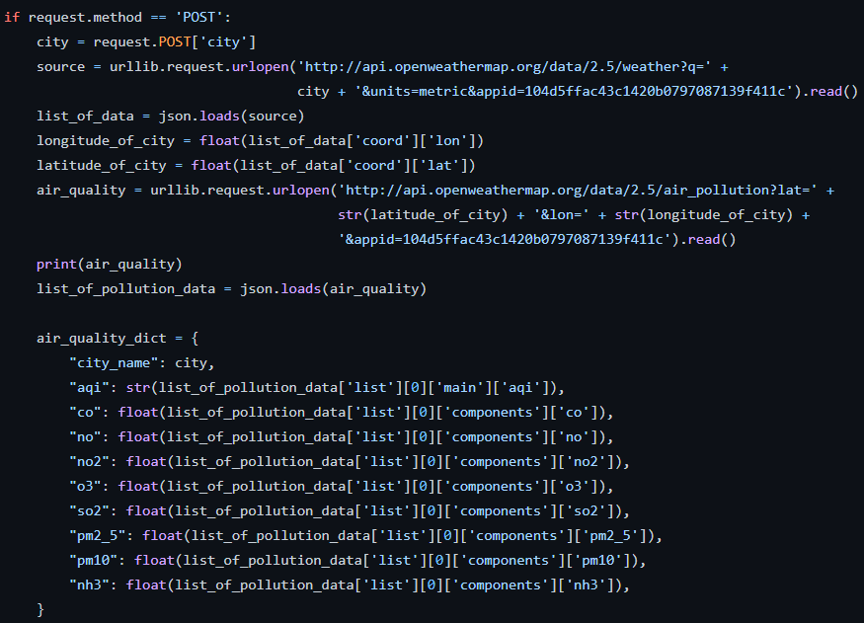
1. Acquisition of data source from a remote source (URL)
URL: https://openweathermap.org/

Slide 7
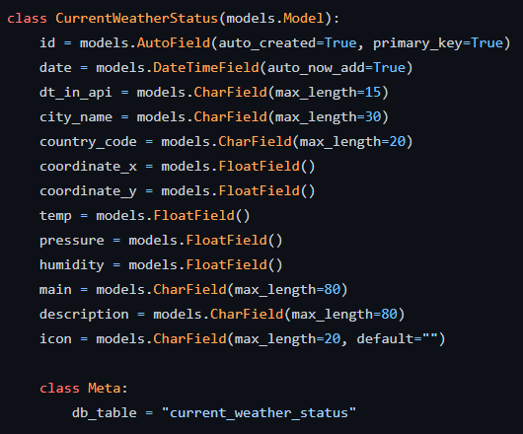
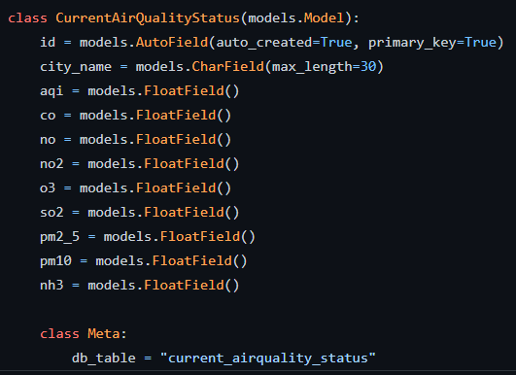
2A. Storing acquired data in a database

Slide 8
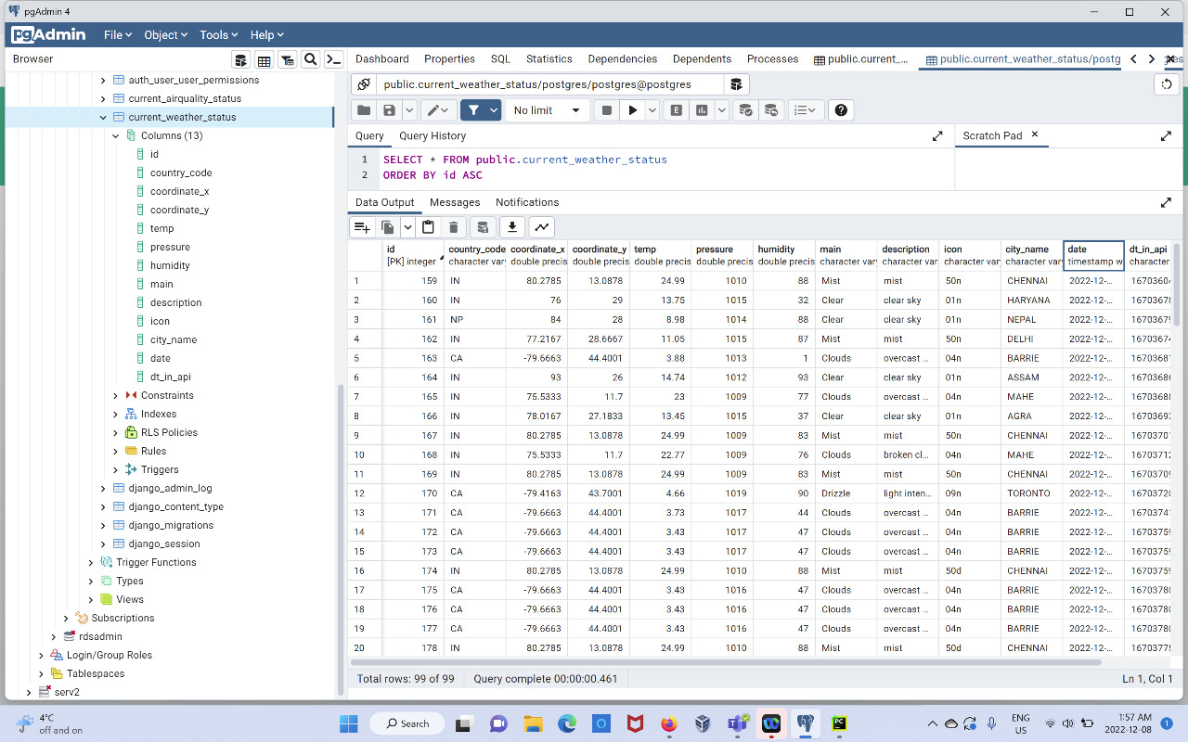
2B.Storing temperature data in PostgreSQl

Slide 9
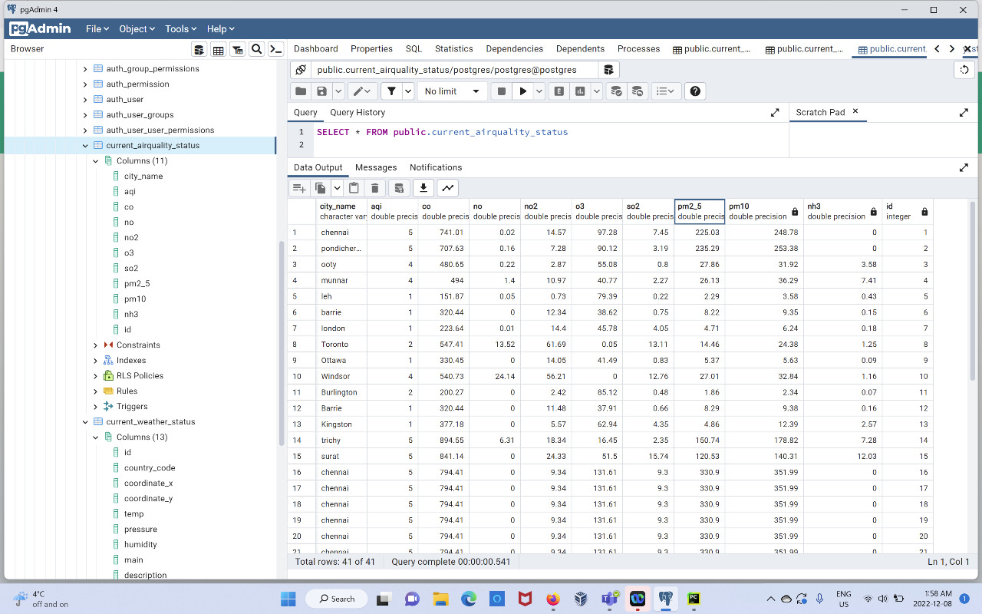
2C.Storing pollution data in PostgreSQl

Slide 10
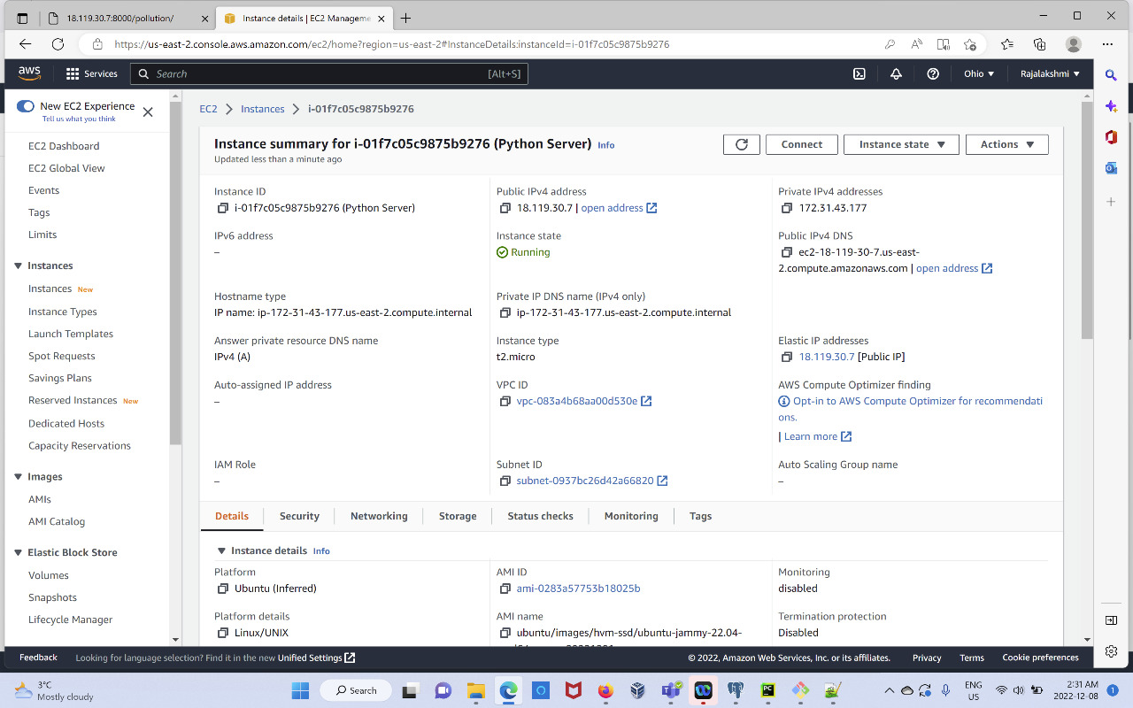
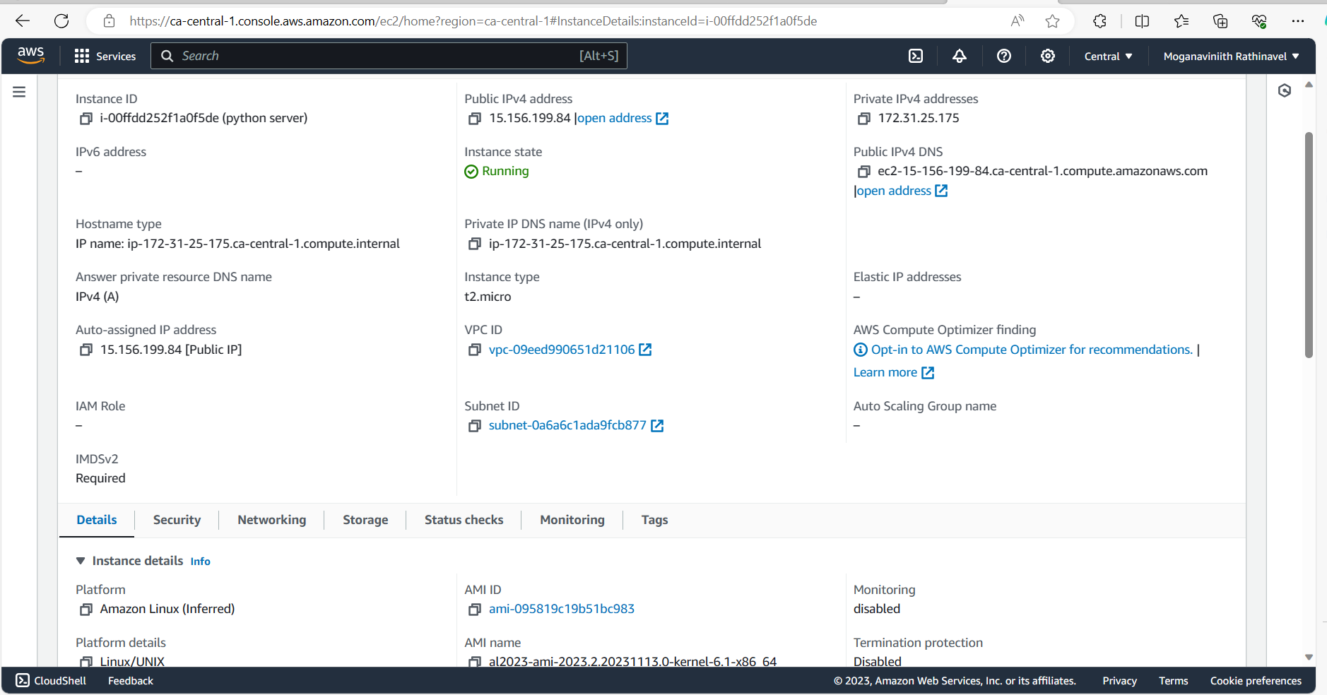
EC2 instance summary
Public IPv4 address:
Weather App
http://15.156.199.84:8000/

Slide 11
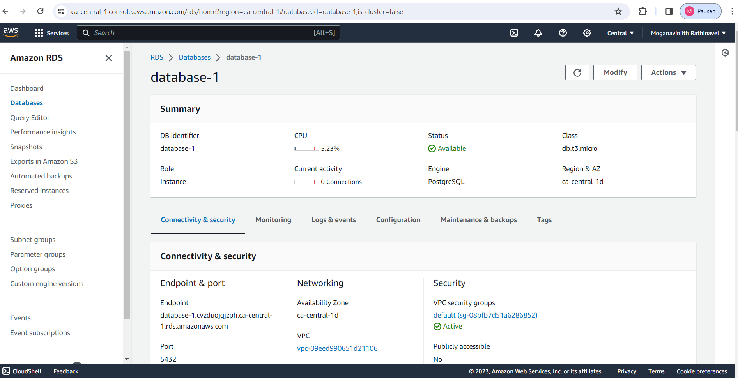
RDS management console
Endpoint
Database:1.cvzduojqjzph.ca-central-1.rds.amazonaws.com Port:5432

Slide 12
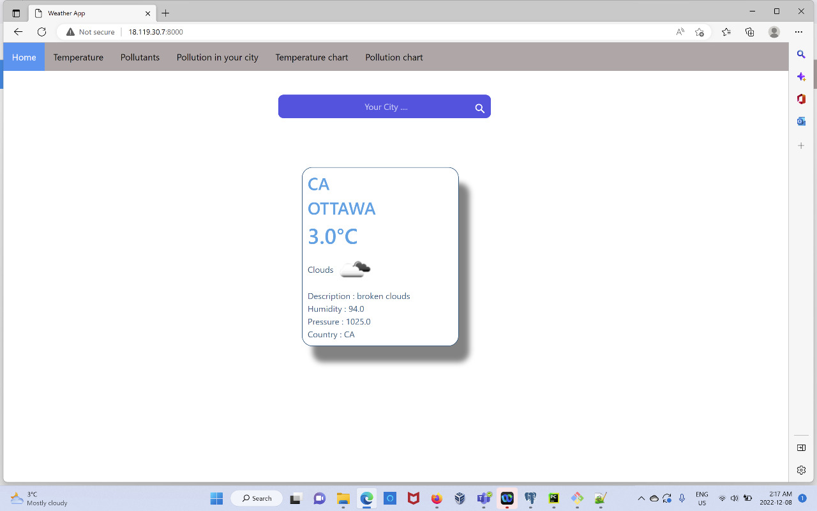
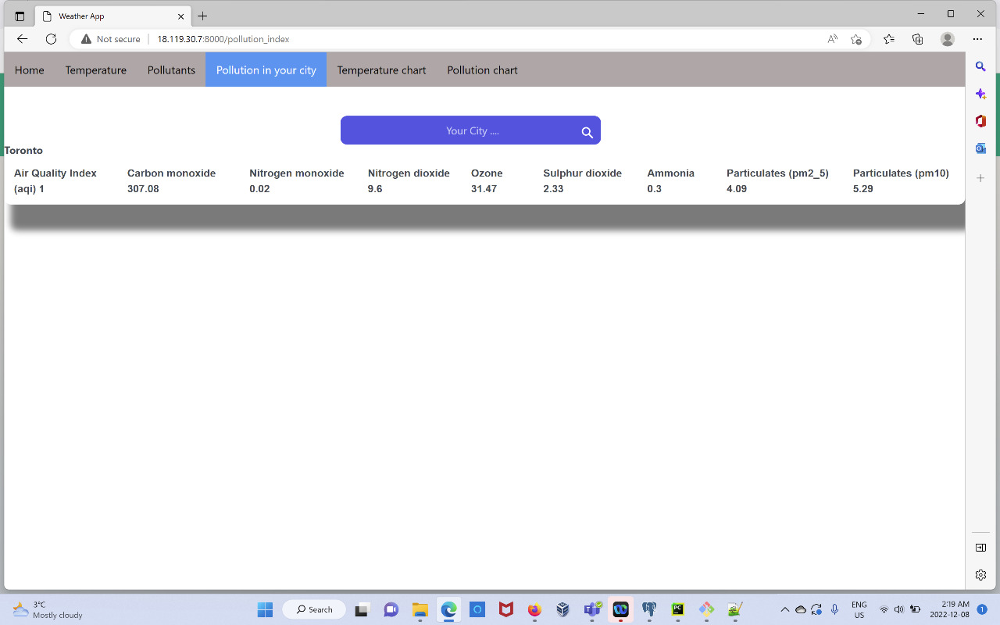
3. PROJECTING RESULTS ON AWS CLOUD SERVER

Slide 13
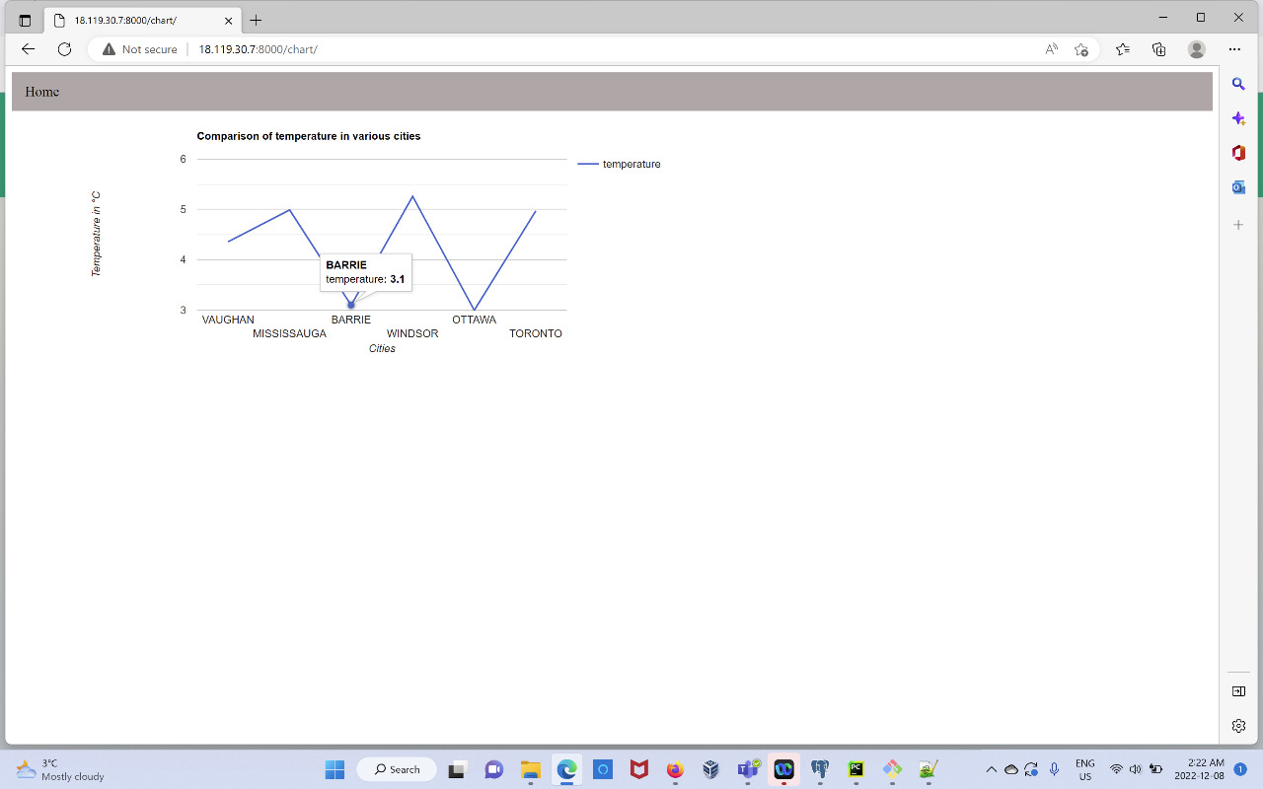
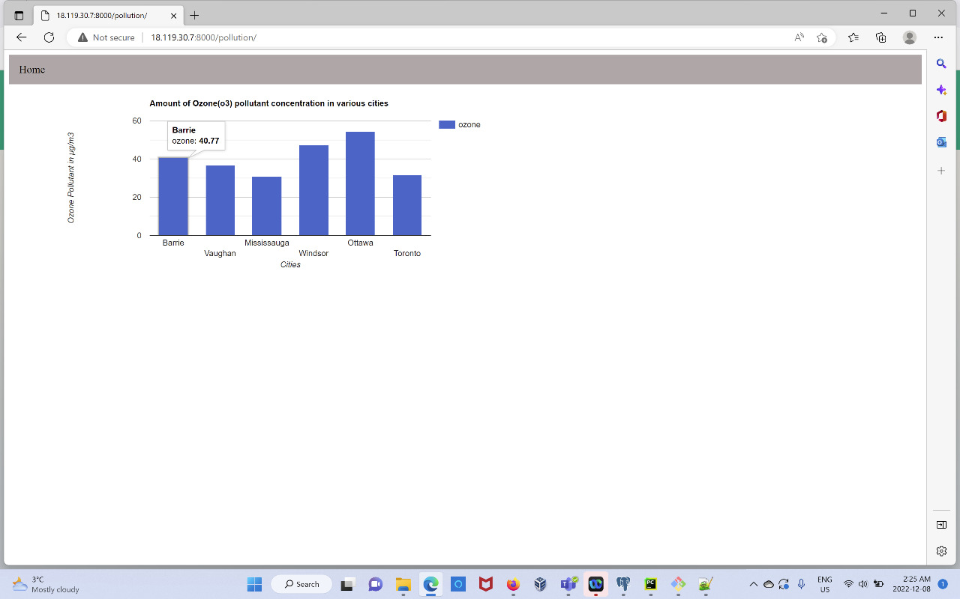
3B.DATA VISUALIZATION USING GOOGLE CHARTS

Slide 14
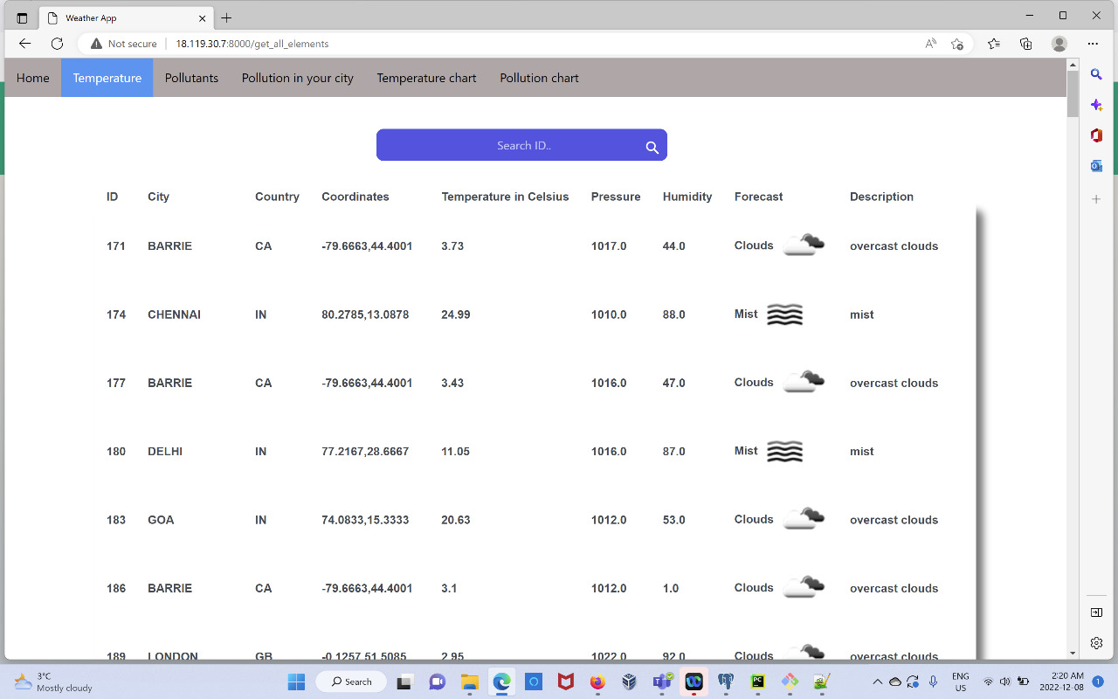
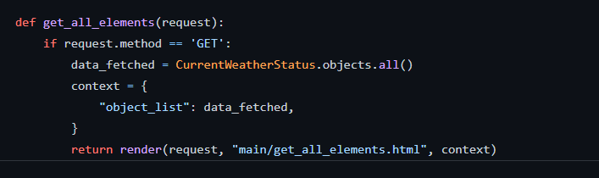
BUILDING API TO SERVE DATA FROM CLOUD
GET ALL ELEMENTS:

Slide 15
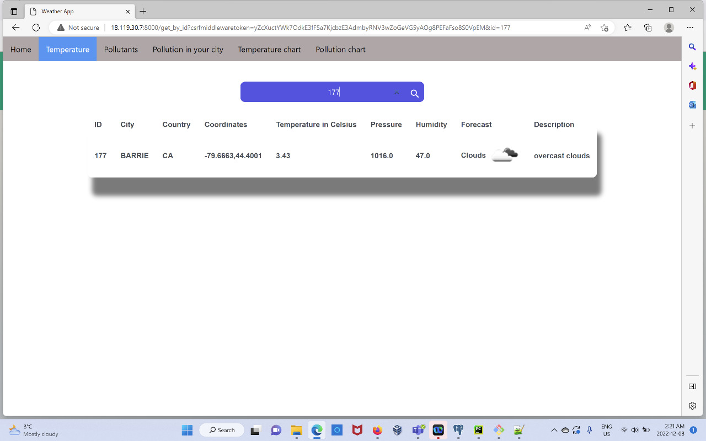
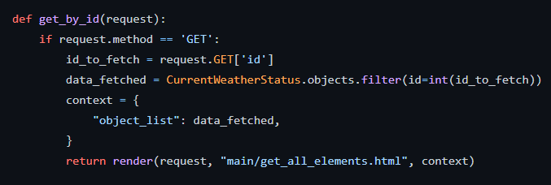
BUILDING API TO SERVE DATA FROM CLOUD
GET ELEMENTS BY ID:

Slide 16
GitHub URL:
Web-App-for-Temperature-and-Pollution-Analysis-MOGANAVINIITH-RATHINAVEL(GITHUB)
References:
https://openweathermap.org/
Django Deployment | Deploy django application on AWS EC2 (programink.com)
How to Dynamically Generate Google Charts in Django – YouTube
Django Project: Build Weather App | From Scratch – YouTube

Slide 17


